Slide 1
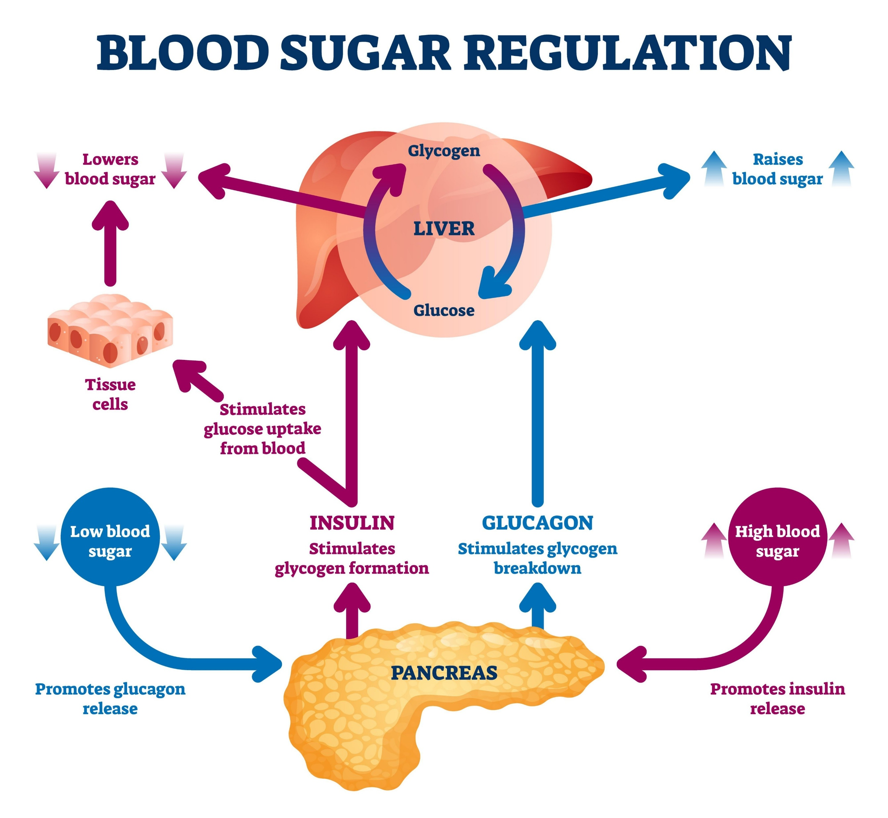
Blood Glucose Control
Learning Objectives:
• Describe the role of the pancreas and liver.
• Explain how insulin and glucagon interact.
• Evaluate treatments for Type 1 and Type 2 diabetes.
Keywords: Pancreas, Insulin, Glucagon, Glycogen, Homeostasis.

Slide 2
Entrance Activity (Do Now)
1. What is the 'master gland' in the endocrine system?
2. Define Homeostasis.
3. Why must blood glucose be kept at a constant level?

Slide 3
Entrance Answers
1. The Pituitary Gland.
2. Maintenance of a constant internal environment.
3. To ensure cells have enough energy for respiration without damaging tissues.

Slide 4
The Pancreas: The Monitor
The pancreas acts as a sensor.
It constantly monitors the concentration of glucose in the blood.
It produces hormones (chemical messengers) to fix any changes.

Slide 5
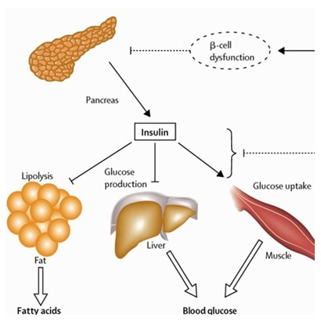
Hormone 1: Insulin
Released when blood glucose is too high.
It moves glucose from the blood into the cells.
It tells the liver to turn glucose into GLYCOGEN (storage).

Slide 6
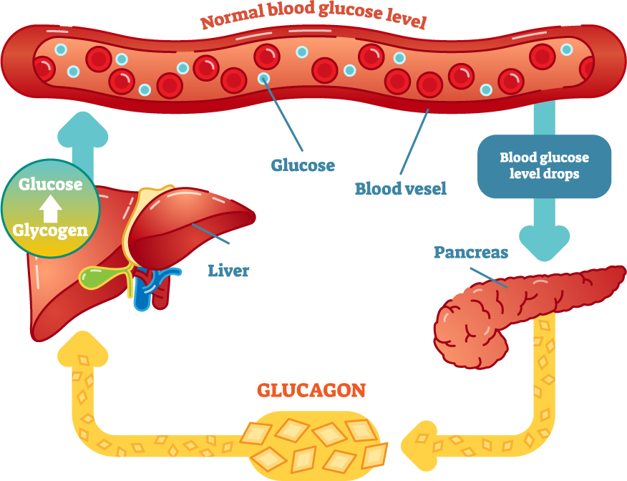
Hormone 2: Glucagon
Released when blood glucose is too low.
It tells the liver to turn GLYCOGEN back into GLUCOSE.
This glucose is released back into the blood.

Slide 7
SEND Support: Memory Tool
How to remember the difference:
'Gluca-GON' is used when the glucose is 'GONE'.
It brings the glucose back!

Slide 8
The Negative Feedback Cycle
High Glucose → Insulin → Glucose drops.
Low Glucose → Glucagon → Glucose rises.
This constant 'teeter-totter' is called Negative Feedback.

Slide 9
Quick Check: A or B?
Which hormone is released after eating a chocolate bar?
A) Glucagon
B) Insulin

Slide 10
Correct Answer
The answer is B) Insulin.
Chocolate increases blood sugar, so the body needs insulin to lower it.

Slide 11
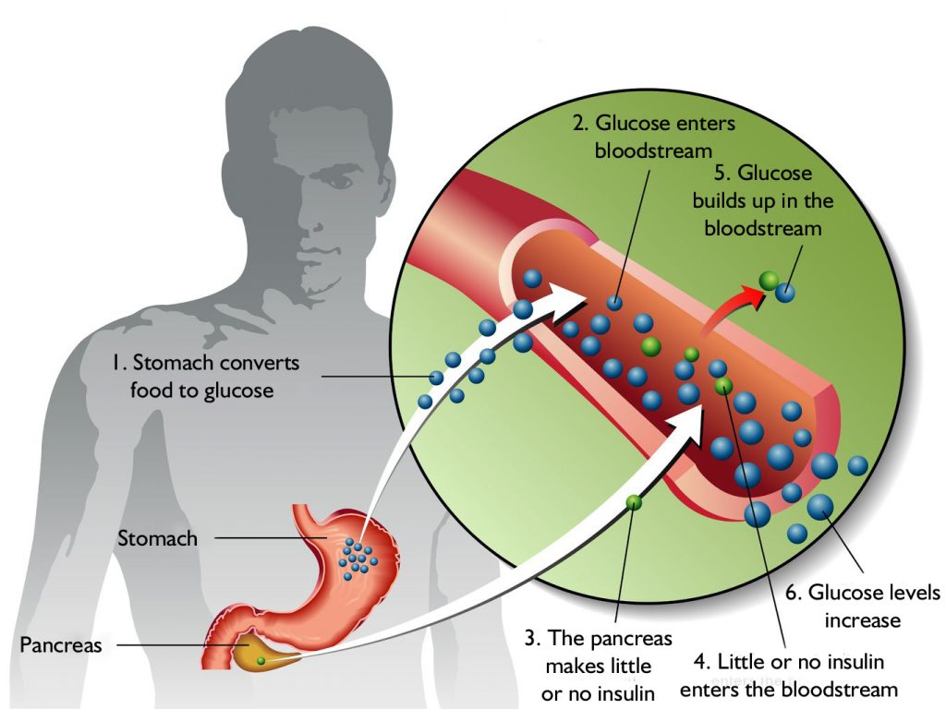
Diabetes: Type 1
Cause: Pancreas doesn't produce enough insulin.
Onset: Usually during childhood/teen years.
Treatment: Insulin injections.

Slide 12
Diabetes: Type 2
Cause: Body cells no longer respond to insulin.
Risk Factor: Obesity and lack of exercise.
Treatment: Controlled diet and exercise.

Slide 13
Task: Compare the Types
Create a table with two columns: Type 1 and Type 2.
Sort these: Obesity, Injections, Cells don't respond, Early onset.

Slide 14
Sorting Task: Answers
Type 1 | Type 2
Injections | Obesity
Early onset | Cells don’t respond

Slide 15
AQA Skill: Interpreting Graphs
Look at a blood glucose graph (Teacher to display image).
Q: Why does the glucose level spike 30 minutes after a meal?
Q: How can you tell if someone has diabetes from a graph?

Slide 16
Graph Analysis: Answers
1. Spike: Carbohydrates are digested into glucose and absorbed.
2. Diabetes: The glucose levels stay high for much longer.

Slide 17
Exam Practice: Extended Response
Explain how the body maintains blood glucose levels after a meal and after exercise. (6 marks)

Slide 18
Mark Scheme
Meal: Glucose rises, insulin released, glucose to glycogen. (3)
Exercise: Glucose used, glucagon released, glycogen to glucose. (3)

Slide 19
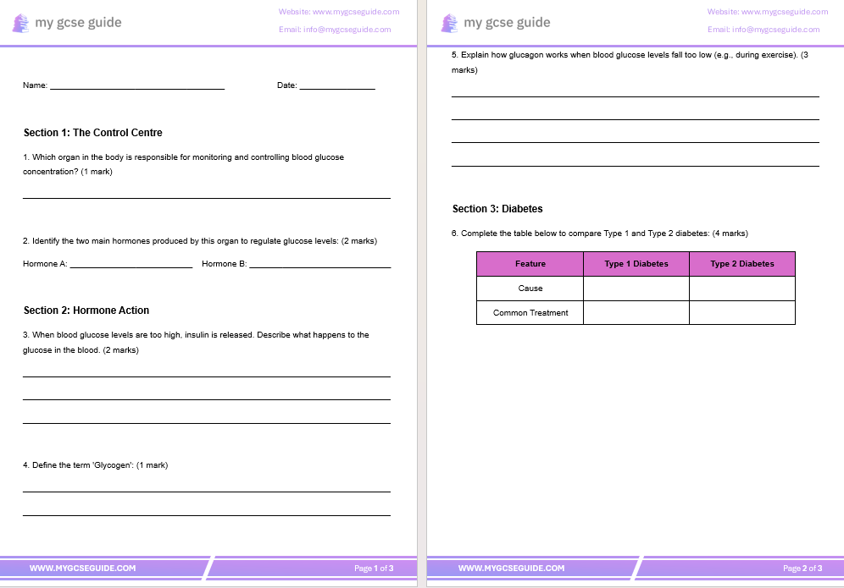
Worksheet
Answer the questions on worksheet.
For extension task use the higher tier questions worksheet.

Slide 20
Mark Scheme
Q1: The Pancreas.
Q2: Insulin and Glucagon.
Q3: Insulin causes glucose to move from blood into cells (1); glucose is converted to glycogen for storage in the liver/muscles (1).
Q4: Glycogen is a storage carbohydrate made of glucose molecules.
Q5: Pancreas detects low levels and releases glucagon (1); Glucagon travels to the liver (1); Glycogen is converted back into glucose and released into the blood (1).
Q6: Type 1 Cause: Pancreas fails to produce insulin. Type 2 Cause: Cells no longer respond to insulin. Type 1 Treatment: Insulin injections. Type 2 Treatment: Carbohydrate-controlled diet/exercise.

Slide 21
Plenary: 60-Second Finish
1. Glycogen is stored in the brain. (F)
2. Glucagon increases blood sugar. (T)
3. Type 2 is mainly caused by genetics. (F)

Slide 22
Next Steps
Write down one thing you learned, one thing you found hard, and one question you still have.

